Slide 1
Linear Regression
CS771: Introduction to Machine Learning
Piyush Rai

Slide 2
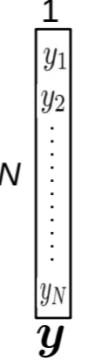
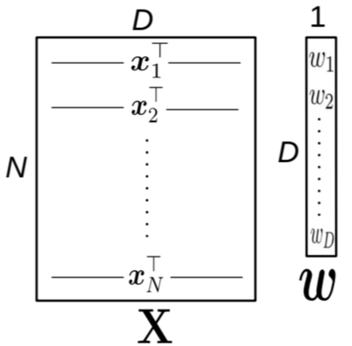

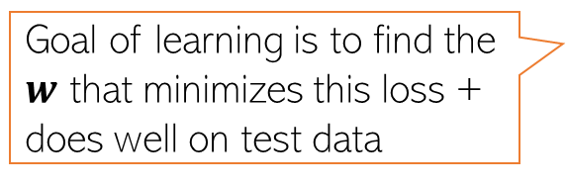

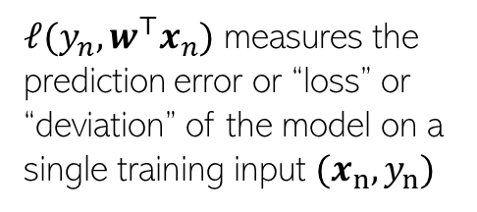
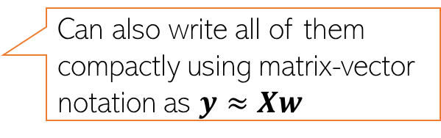
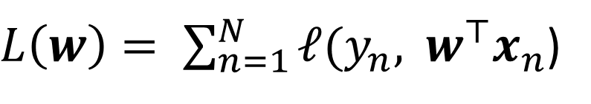
Linear Regression
2
Given: Training data with $N$ input-output pairs ${{\{(x}_{n},y_{n})\}}_{n=1}^{N}$, $x_{n}∈ℝ^{D}$, $y_{n}∈ℝ$
Goal: Learn a model to predict the output for new test inputs
Assume the function that approximates the I/O relationship to be a linear model
Let’s write the total error or “loss” of this model over the training data as
$$y_{n}≈f\left(x_{n}\right)= w^{⊤}x_{n} (n=1,2,…,N)$$
Can also write all of them compactly using matrix-vector notation as $y≈Xw$
Goal of learning is to find the $w$ that minimizes this loss + does well on test data
$L\left(w\right)= \sum_{n=1}^{N}{ℓ(y_{n}, }$ $w^{⊤}x_{n}$)
$ℓ(y_{n},w^{⊤}x_{n})$ measures the
prediction error or “loss” or “deviation” of the model on a single training input ${(x}_{n},y_{n})$
Unlike models like KNN and DT, here we have an explicit problem-specific objective (loss function) that we wish to optimize for

Slide 3
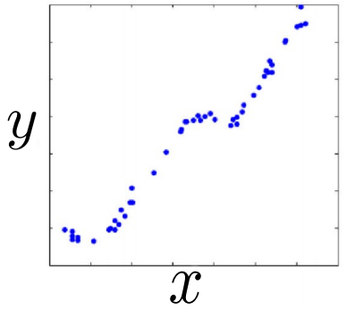
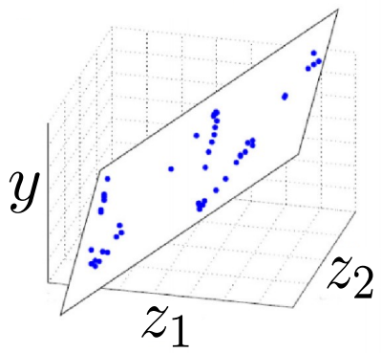
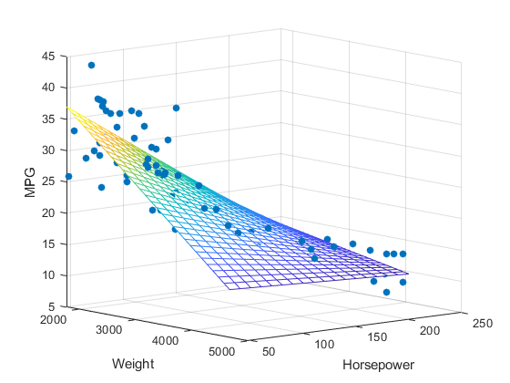




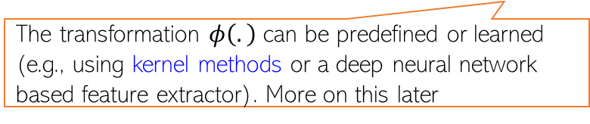

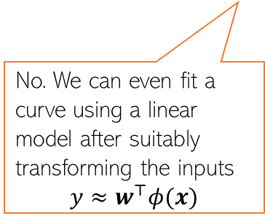
Linear Regression: Pictorially
3
Linear regression is like fitting a line or (hyper)plane to a set of points
The line/plane must also predict outputs the unseen (test) inputs well
$$\left[\begin{aligned}z_{1} \\ z_{2}\end{aligned}\right]=φ(x)$$
What if a line/plane doesn’t model the input-output relationship very well, e.g., if their relationship is better modeled by a nonlinear curve or curved surface?
Original (single) feature
Nonlinear curve needed
Two features
Can fit a plane (linear)
(Output $y$)
(Output $y$)
Do linear models become useless in such cases?
No. We can even fit a curve using a linear model after suitably transforming the inputs
$$y≈w^{⊤}φ(x)$$
Input $x$ (single feature)
(Feature 2)
(Feature 1)
The transformation $φ\left(.\right)$ can be predefined or learned (e.g., using kernel methods or a deep neural network based feature extractor). More on this later

Slide 4
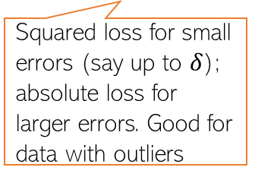


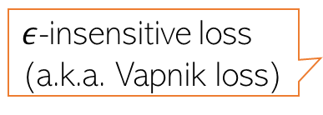









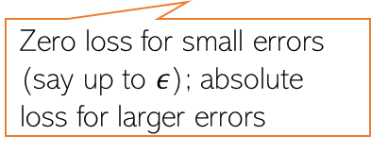
Loss Functions for Regression
4
Choice of loss function usually depends on the nature of the data. Also, some loss functions result in easier optimization problem than others
Many possible loss functions for regression problems
Squared loss
Loss
$${(y_{n}−f(x_{n}))}^{2}$$
Absolute loss
Loss
$${|y}_{n}−f\left(x_{n}\right)|$$
Very commonly used for regression. Leads to an easy-to-solve optimization problem
Grows more slowly than squared loss. Thus better suited when data has some outliers (inputs on which model makes large errors)
${y_{n}− f(x}_{n}$)
${y_{n}− f(x}_{n}$)
Loss
Huber loss
Loss
$${|y}_{n}−f\left(x_{n}\right)|−ε$$
Squared loss for small errors (say up to $δ$); absolute loss for larger errors. Good for data with outliers
$ε$-insensitive loss
(a.k.a. Vapnik loss)
Note: Can also use squared loss instead of absolute loss
Zero loss for small errors (say up to $ε$); absolute loss for larger errors
$$−δ$$
$$δ$$
${y_{n}− f(x}_{n}$)
$$−ε$$
$$ε$$
${y_{n}− f(x}_{n}$)

Slide 5

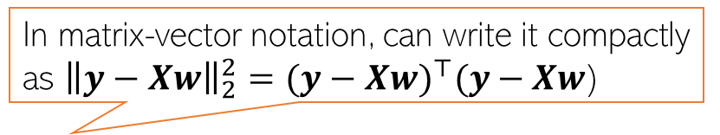
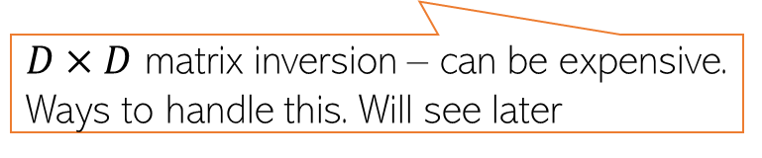
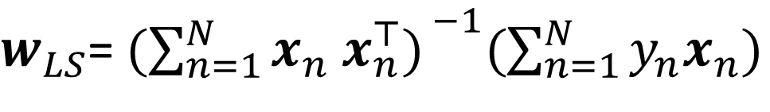


Linear Regression with Squared Loss
5
In matrix-vector notation, can write it compactly as ${\left\|y−Xw\right\|}_{2}^{2}={(y−Xw)}^{⊤}(y−Xw$)
In this case, the loss func will be
Let us find the $w$that optimizes (minimizes) the above squared loss
We need calculus and optimization to do this!
The LS problem can be solved easily and has a closed form solution
$L\left(w\right)=$ $\sum_{n=1}^{N}{{(y_{n}−w^{⊤}x_{n})}^{2}}$
The “least squares” (LS) problem Gauss-Legendre, 18th century)
Closed form solutions to ML problems are rare.
$w_{LS}$= ${\text{arg} \text{min}}_{w} L\left(w\right)={\text{arg} \text{min}}_{w}\sum_{n=1}^{N}{{(y_{n}−w^{⊤}x_{n})}^{2}}$
$w_{LS}$= ${(\sum_{n=1}^{N}{x_{n} x_{n}^{⊤}) }}^{−1}(\sum_{n=1}^{N}{y_{n}x_{n}})$
$${=(X^{⊤}X)}^{−1}X^{⊤}y$$
$D×D$ matrix inversion – can be expensive. Ways to handle this. Will see later

Slide 6

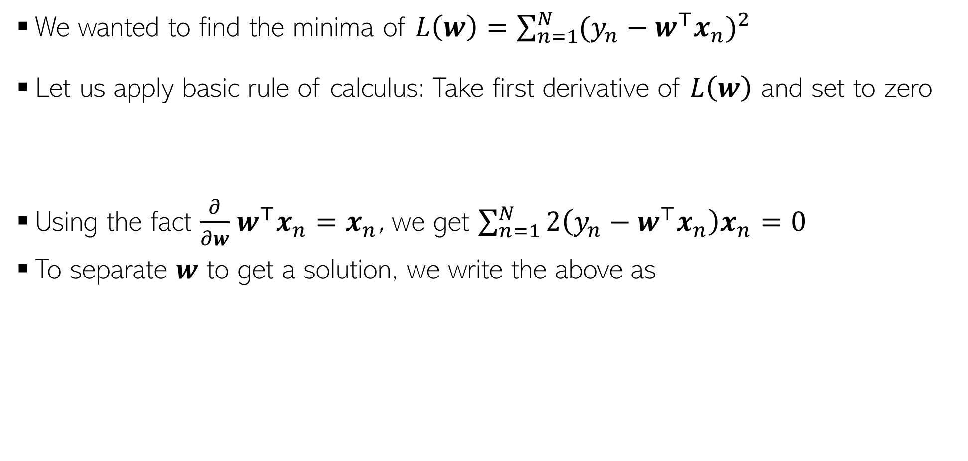
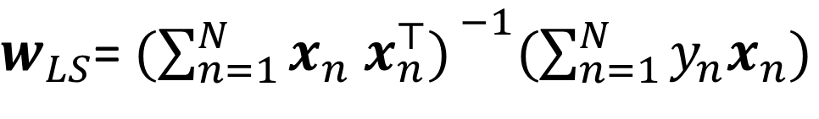

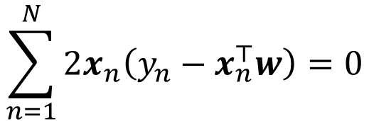

Proof: A bit of calculus/optim. (more on this later)
6
We wanted to find the minima of $L\left(w\right)=\sum_{n=1}^{N}{{(y_{n}−w^{⊤}x_{n})}^{2}}$
Let us apply basic rule of calculus: Take first derivative of $L\left(w\right)$ and set to zero
Using the fact $\frac{∂}{∂w}$ $w^{⊤}x_{n}=x_{n}$, we get $\sum_{n=1}^{N}{2\left(y_{n}−w^{⊤}x_{n}\right)x_{n}=0}$
To separate $w$ to get a solution, we write the above as
Chain rule of calculus
$\frac{∂L\left(w\right)}{∂w}=\frac{∂}{∂w}$ $\sum_{n=1}^{N}{{(y_{n}−w^{⊤}x_{n})}^{2}}=\sum_{n=1}^{N}{2\left(y_{n}−w^{⊤}x_{n}\right)\frac{∂}{∂w}}\left(y_{n}−w^{⊤}x_{n}\right)=0$
Partial derivative of dot product w.r.t each element of $w$
Result of this derivative is $x_{n}$ - same size as $w$
$$\sum_{n=1}^{N}{2x_{n}\left(y_{n}−x_{n}^{⊤}w\right)=0}$$
$$\sum_{n=1}^{N}{y_{n}x_{n}−x_{n}x_{n}^{⊤}w=0}$$
$w_{LS}$= ${(\sum_{n=1}^{N}{x_{n} x_{n}^{⊤}) }}^{−1}(\sum_{n=1}^{N}{y_{n}x_{n}})$
$${=(X^{⊤}X)}^{−1}X^{⊤}y$$

Slide 7
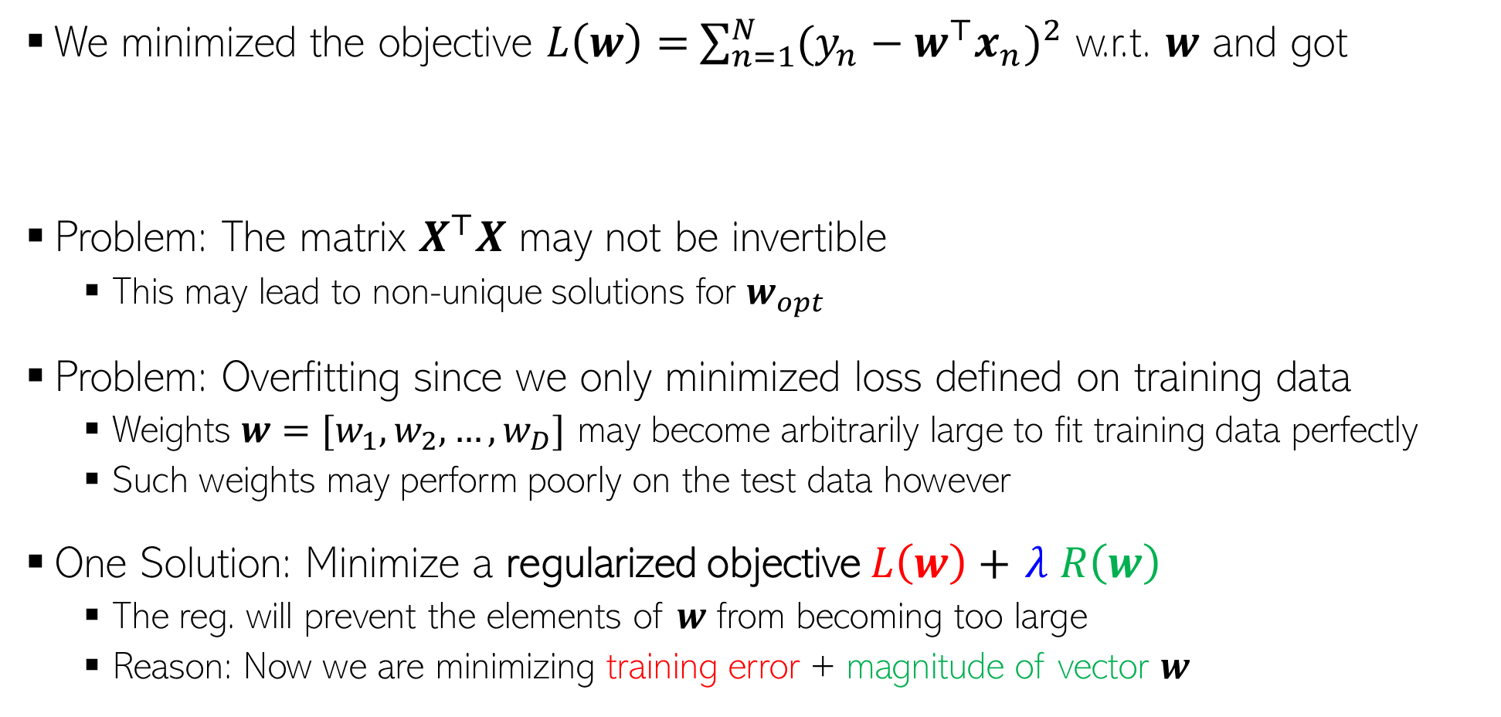
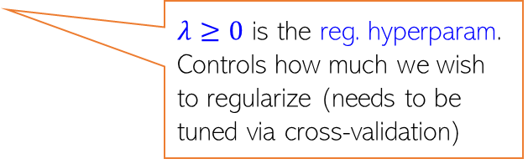
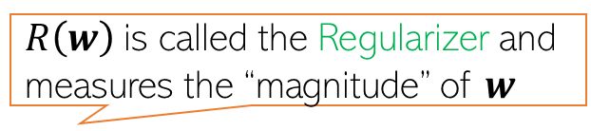

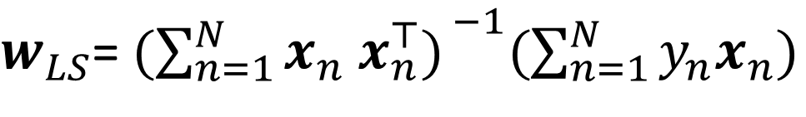
Problem(s) with the Solution!
7
We minimized the objective $L\left(w\right)=$ $\sum_{n=1}^{N}{{(y_{n}−w^{⊤}x_{n})}^{2}}$ w.r.t. $w$ and got
Problem: The matrix $X^{⊤}X$ may not be invertible
This may lead to non-unique solutions for $w_{opt}$
Problem: Overfitting since we only minimized loss defined on training data
Weights $w=[w_{1},w_{2},…,w_{D}]$ may become arbitrarily large to fit training data perfectly
Such weights may perform poorly on the test data however
One Solution: Minimize a regularized objective $L\left(w\right)+$ $λ R\left(w\right)$
The reg. will prevent the elements of $w$ from becoming too large
Reason: Now we are minimizing training error + magnitude of vector $w$
$w_{LS}$= ${(\sum_{n=1}^{N}{x_{n} x_{n}^{⊤}) }}^{−1}(\sum_{n=1}^{N}{y_{n}x_{n}})$
$${=(X^{⊤}X)}^{−1}X^{⊤}y$$
$R\left(w\right)$is called the Regularizer and measures the “magnitude” of $w$
$λ≥0$ is the reg. hyperparam. Controls how much we wish to regularize (needs to be tuned via cross-validation)

Slide 8


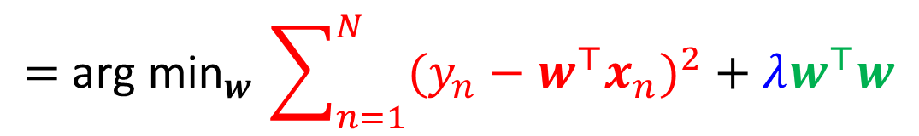
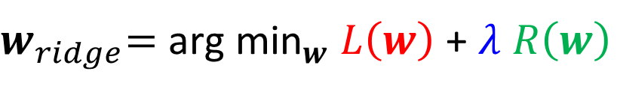
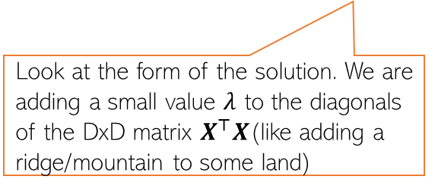

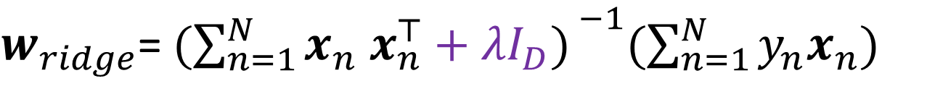
Regularized Least Squares (a.k.a. Ridge Regression)
Recall that the regularized objective is of the form $L_{reg}(w)= L\left(w\right)+λ R\left(w\right)$
One possible/popular regularizer: the squared Euclidean ($ℓ_{2}$ squared) norm of $w$
With this regularizer, we have the regularized least squares problem as
Proceeding just like the LS case, we can find the optimal $w$ which is given by
$$R\left(w\right)= {\left\|w\right\|}_{2}^{2}= w^{⊤}w$$
Look at the form of the solution. We are adding a small value $λ$ to the diagonals of the DxD matrix $X^{⊤}X$(like adding a ridge/mountain to some land)
$w_{ridge}\text{=} {\text{arg} \text{min}}_{w} L\left(w\right)$ + $λ R\left(w\right)$
$${\text{= }\text{arg} \text{min}}_{w}\sum_{n=1}^{N}{{(y_{n}−w^{⊤}x_{n})}^{2}}+λw^{⊤}w$$
Why is the method called “ridge” regression
$w_{ridge}$= ${(\sum_{n=1}^{N}{x_{n} x_{n}^{⊤}+λI_{D}) }}^{−1}(\sum_{n=1}^{N}{y_{n}x_{n}})$
$${=(X^{⊤}X+λI_{D})}^{−1}X^{⊤}y$$

Slide 9



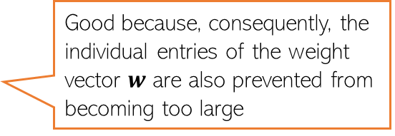

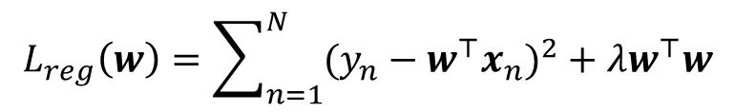



A closer look at $ℓ_{2}$ regularization
Remember – in general, weights with large magnitude are bad since they can cause overfitting on training data and may not work well on test data
The regularized objective we minimized is
Minimizing $L_{reg}\left(w\right)$w.r.t. $w$ gives a solution for $w$ that
Keeps the training error small
Has a small $ℓ_{2}$ squared norm $w^{⊤}w$ = $\sum_{d=1}^{D}{w_{d}^{2}}$
Small entries in $w$ are good since they lead to “smooth” models
$$L_{reg}\left(w\right)=\sum_{n=1}^{N}{{(y_{n}−w^{⊤}x_{n})}^{2}}+λw^{⊤}w$$
Good because, consequently, the individual entries of the weight vector $w$ are also prevented from becoming too large
Not a “smooth” model since its test data predictions may change drastically even with small changes in some feature’s value
A typical $w$ learned without $ℓ_{2}$ reg.
$$x_{n}=$$
1.2
0.5
2.4
0.3
0.8
0.1
0.9
2.1
$$y_{n}=0.8$$
3.2
1.8
1.3
2.1
10000
2.5
3.1
0.1
$$x_{m}=$$
$$y_{m}=100$$
1.2
0.5
2.4
0.3
0.8 $+ ε$
0.1
0.9
2.1
Just to fit the training data where one of the inputs was possibly an outlier, this weight became too big. Such a weight vector will possibly do poorly on normal test inputs
Exact same feature vectors only differing in just one feature by a small amount
Very different outputs though (maybe one of these two training ex. is an outlier)

Slide 10

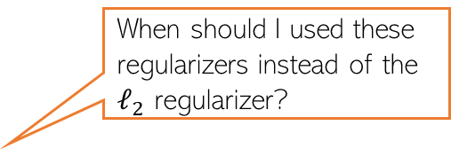
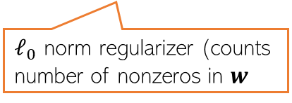



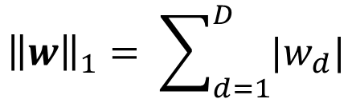
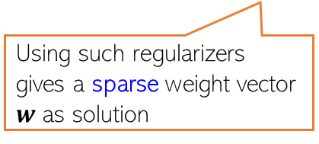
Other Ways to Control Overfitting
Note that optimizing loss functions with such regularizers is usually harder than ridge reg. but several advanced techniques exist (we will see some of those later)
Use a regularizer $R\left(w\right)$ defined by other norms, e.g.,
Use non-regularization based approaches
Early-stopping (stopping training just when we have a decent val. set accuracy)
Dropout (in each iteration, don’t update some of the weights)
Injecting noise in the inputs
$ℓ_{1}$ norm regularizer
Use them if you have a very large number of features but many irrelevant features. These regularizers can help in automatic feature selection
$${\left\|w\right\|}_{1}= \sum_{d=1}^{D}{|w_{d}|}$$
When should I used these regularizers instead of the $ℓ_{2}$ regularizer?
$${\left\|w\right\|}_{0}=\#nnz(w)$$
Using such regularizers gives a sparse weight vector $w$ as solution
sparse means many entries in $w$ will be zero or near zero. Thus those features will be considered irrelevant by the model and will not influence prediction
Automatic feature selection? Wow, cool!!!
But how exactly?
$ℓ_{0}$ norm regularizer (counts number of nonzeros in $w$
All of these are very popular ways to control overfitting in deep learning models. More on these later when we talk about deep learning

Slide 11
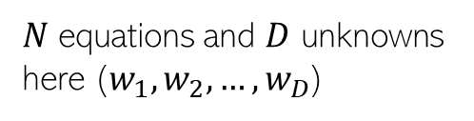
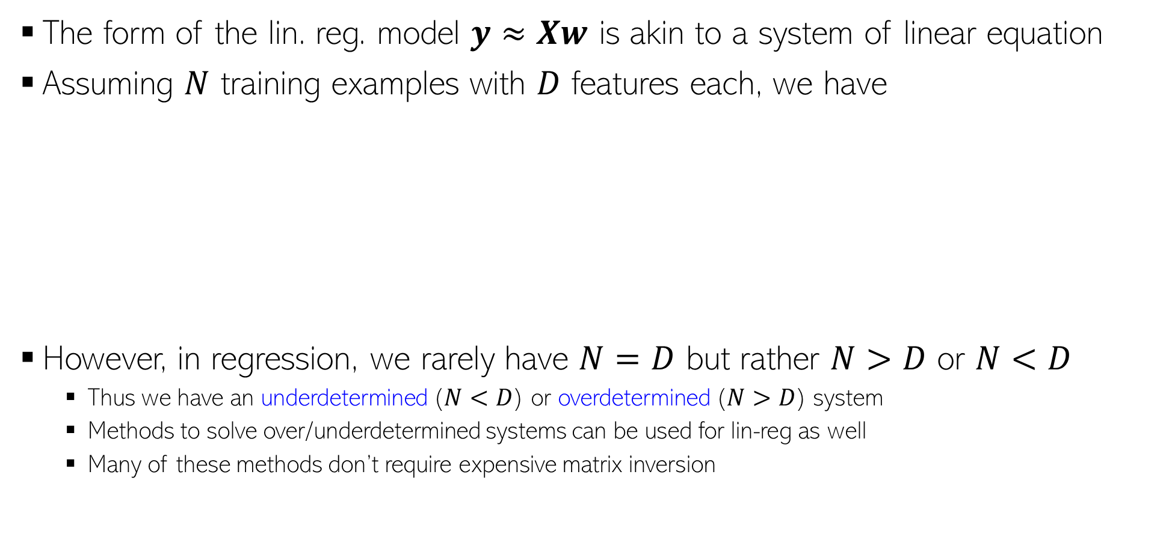
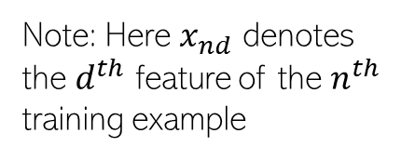

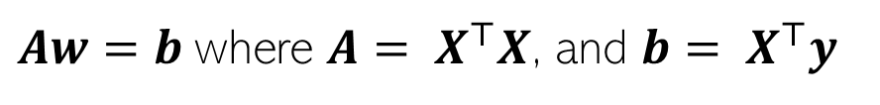


Linear Regression as Solving System of Linear Eqs
The form of the lin. reg. model $y≈Xw$ is akin to a system of linear equation
Assuming $N$ training examples with $D$ features each, we have
However, in regression, we rarely have $N=D$ but rather $N>D$ or $N<D$
Thus we have an underdetermined ($N<D$) or overdetermined ($N>D$) system
Methods to solve over/underdetermined systems can be used for lin-reg as well
Many of these methods don’t require expensive matrix inversion
First training example:
$$y_{1}=x_{11}w_{1}+x_{12}w_{2}+ …+x_{1D}w_{D}$$
Note: Here $x_{nd}$ denotes the $d^{th}$ feature of the $n^{th}$ training example
Second training example:
$$y_{2}=x_{21}w_{1}+x_{22}w_{2}+ …+x_{2D}w_{D}$$
$N$ equations and $D$ unknowns here ($w_{1},w_{2},…,w_{D}$)
N-th training example:
$$y_{N}=x_{N1}w_{1}+x_{N2}w_{2}+ …+x_{ND}w_{D}$$
Now solve this!
Solving lin-reg
as system of lin eq.
$$w{=(X^{⊤}X)}^{−1}X^{⊤}y$$
$Aw=b$ where ${A= X}^{⊤}X$, and ${b= X}^{⊤}y$
System of lin. Eqns with $D$ equations and $D$ unknowns

Slide 12
Next Lecture
Solving linear regression using iterative optimization methods
Faster and don’t require matrix inversion
Brief intro to optimization techniques

